Slide 1


CACYOF ROADMAP
RAISING KINGS AND PRIESTS TO
ADVANCE THE
KINGDOM OF GOD
Pastor Peter Olanrewaju
Director of Youth Affairs, CAC Nigeria & Overseas
2025

Slide 2
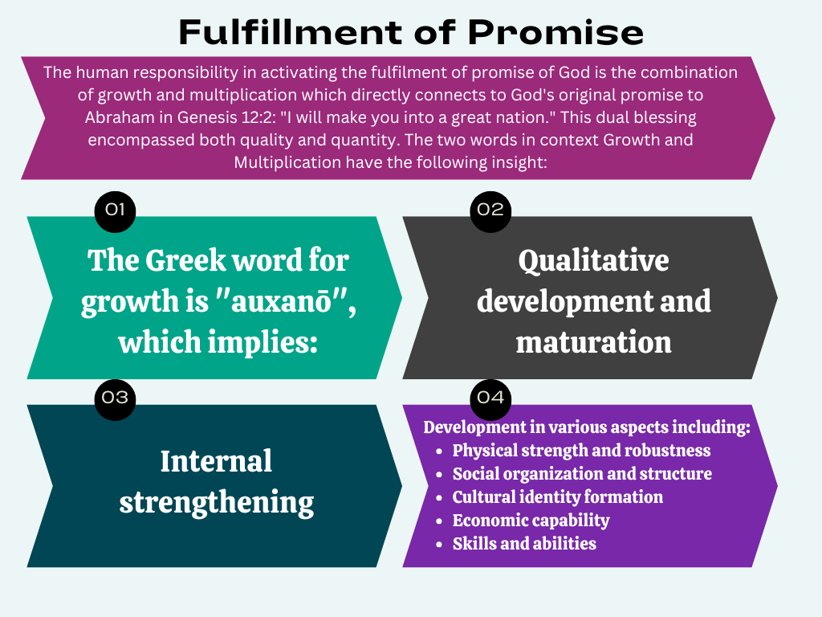

Slide 3
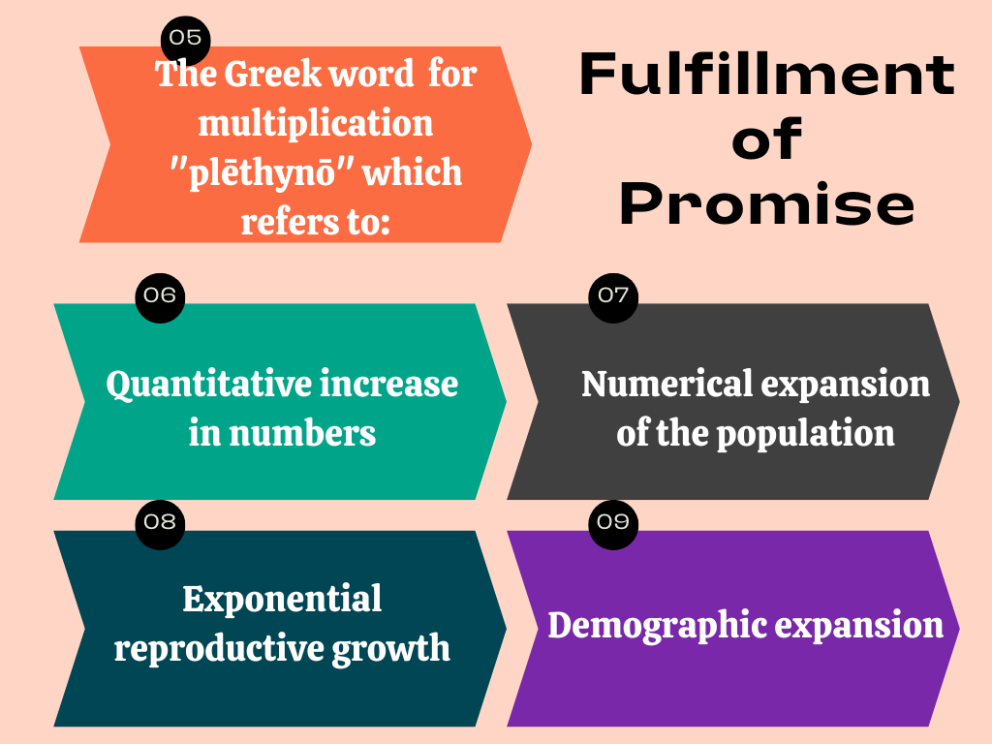

Slide 4

Strategic Vision
Raising Kings and Priests to Advance the Kingdom of God in All Spheres of Society (Revelation 5:10)
This vision calls for youth who excel as Kings in their fields of endeavour while maintaining strong spiritual stand as Priests in Christ.

Slide 5
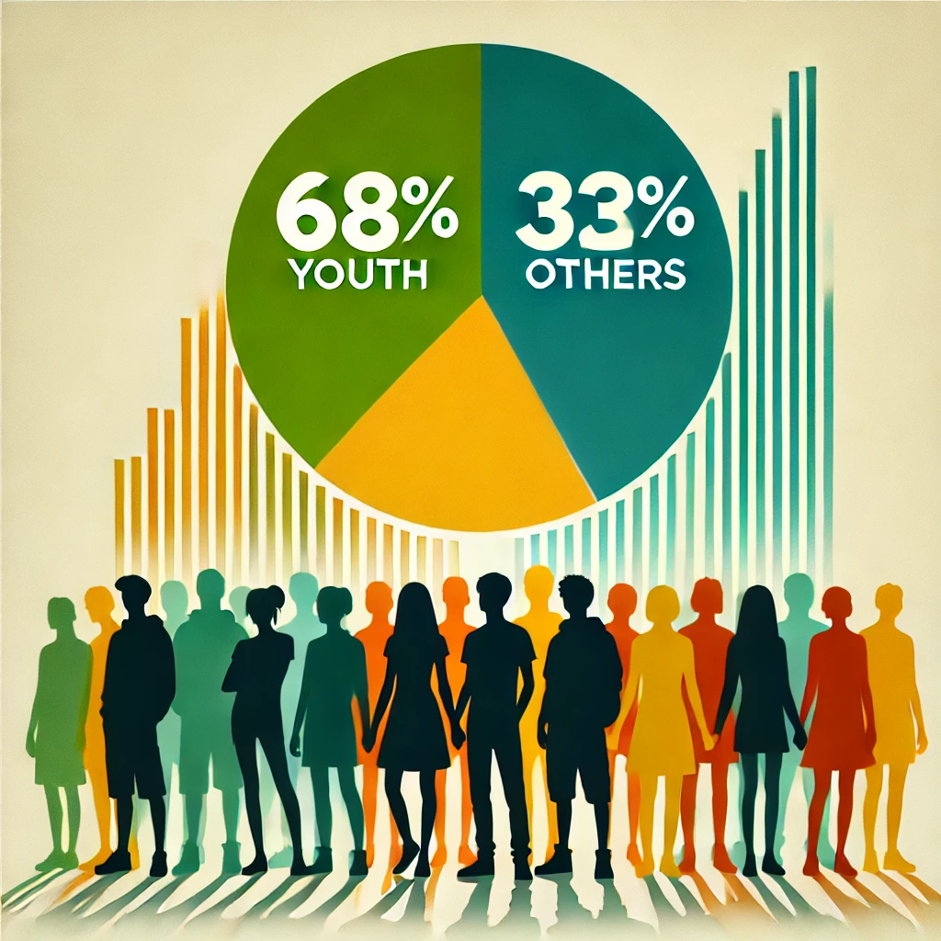
Youth Impact Statistics
We are the key assets for the spiritual growth and leadership

Slide 6
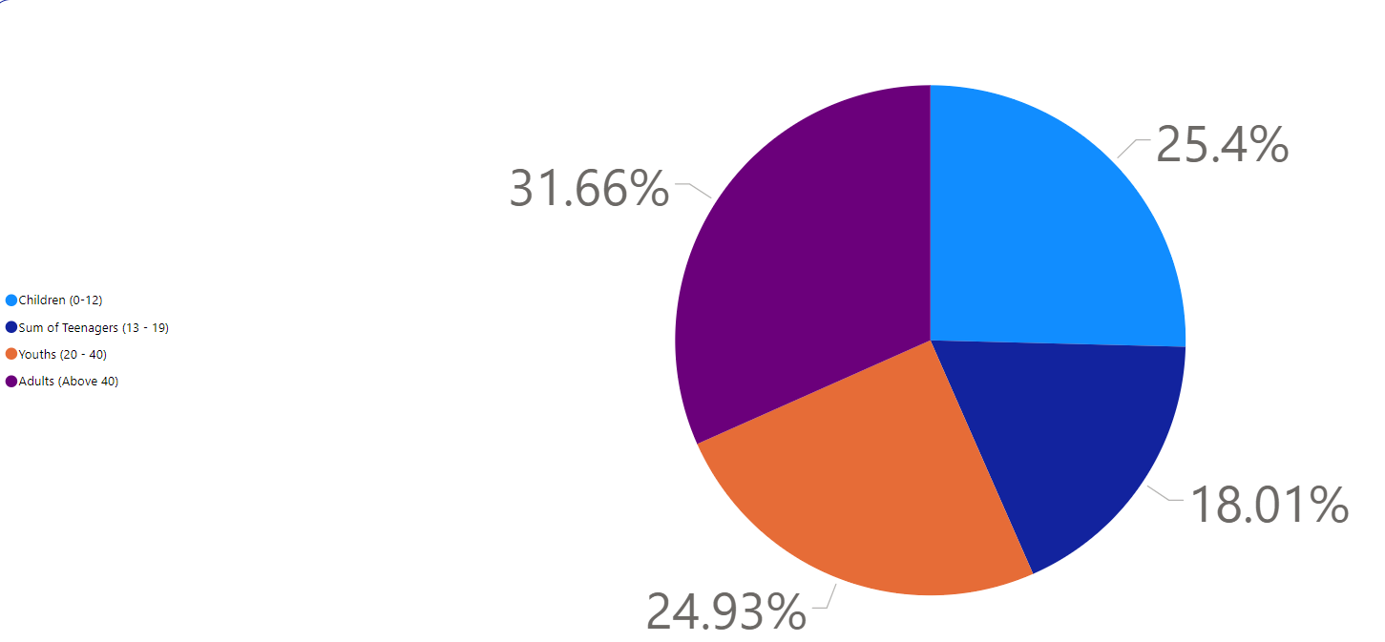
Children (0–12 years):
Represent 25.4% of the population. This indicates that about one-quarter of the population falls into this age group.
Teenagers (13–19 years):
Account for 18.01% of the population, which is the smallest segment among the four groups.
Youths (20–40 years):
Comprise 24.93% of the population, which is slightly less than the children’s group but close in percentage.
Adults (Above 40 years):
Form the largest group, constituting 31.66% of the population, highlighting that a significant portion of the population is older than 40.
Demographic Majority: Youth comprise 68% of the church's population, making them a significant resource for growth and influence.
Future Leaders: They are the future of the church, destined to take on leadership roles in both spiritual and societal domains.
Catalysts for Innovation: Youth bring fresh perspectives, creativity, and energy to ministry and community initiatives.
Agents of Transformation: Their active involvement can drive impactful evangelism, church expansion, and community development.
Global Outreach Potential: Empowered youth can become Kingdom influencers locally and internationally, fulfilling the mission of the church.

Slide 7
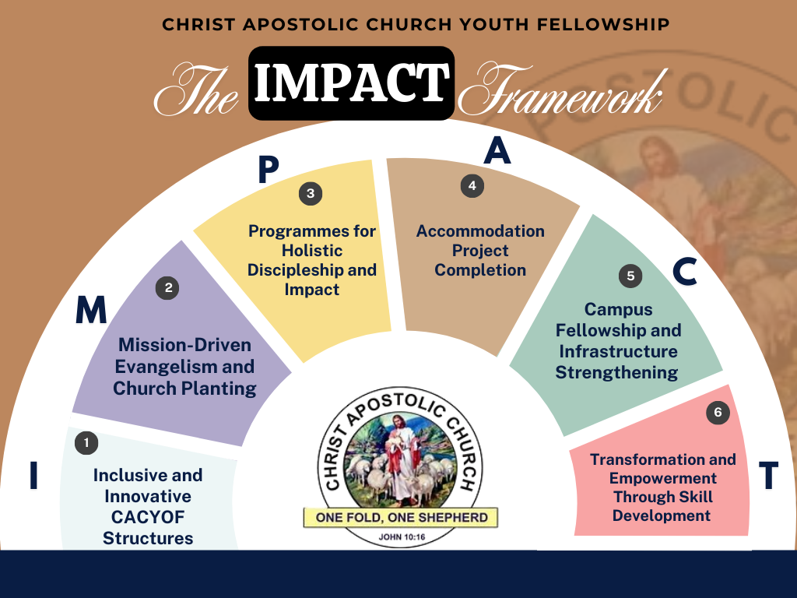

Slide 8
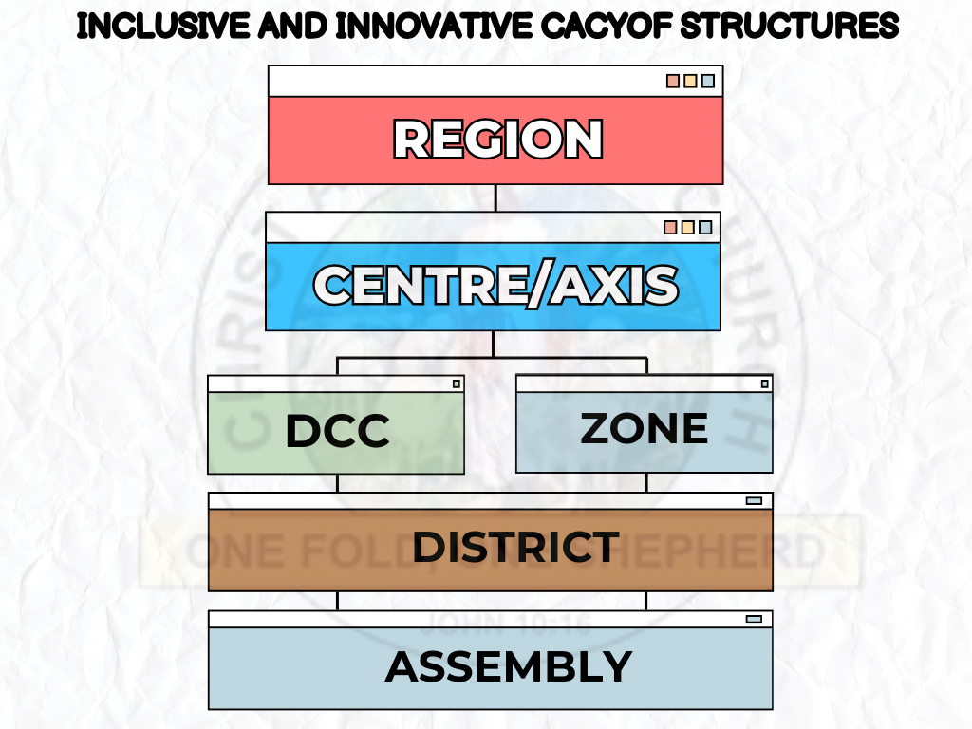
Leadership Development and Structure:
Produce the CACYOF operational rules and regulations handbook.
Introduce age-specific subgroups for teenagers (13-19), young adults (20-30), and emerging leaders (31-40).
Conduct regional leadership training for assembly leaders, sister leaders, and secretaries.
Digital and Operational Integration:
Use digital tools for performance tracking, communication, mentorship, and event coordination through mobile apps and platforms.
Publish quarterly newsletters and social media updates to ensure transparency and visibility.
Engagement and Transition Strategies:
Strengthen grassroots leadership via quarterly business meetings for coordinators and committee heads.
Create a seamless transition strategy for older youth (40+) into CACMA and Good Women Fellowship for continued involvement.

Slide 9
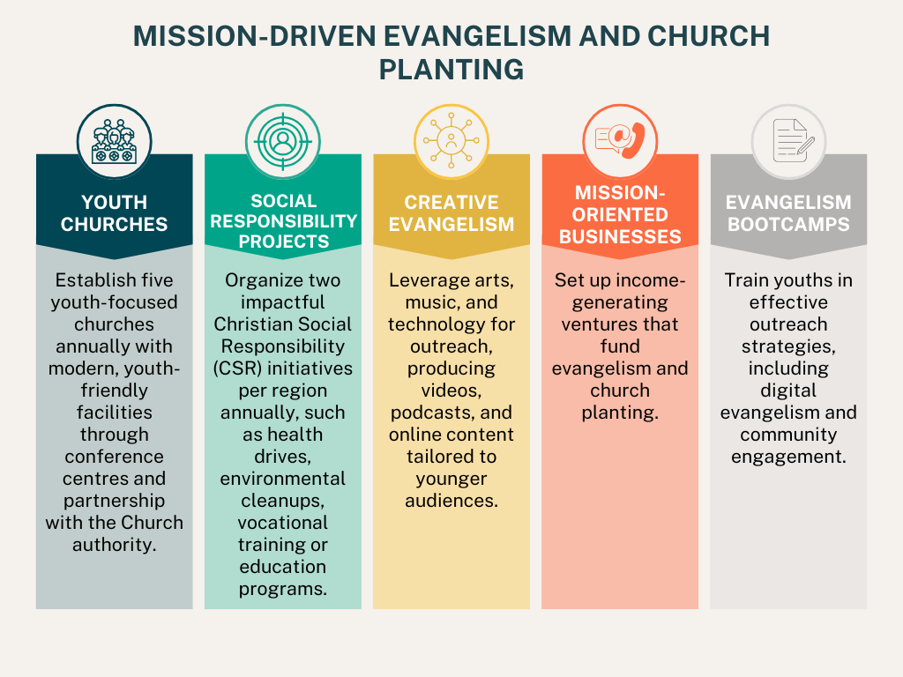

Slide 10
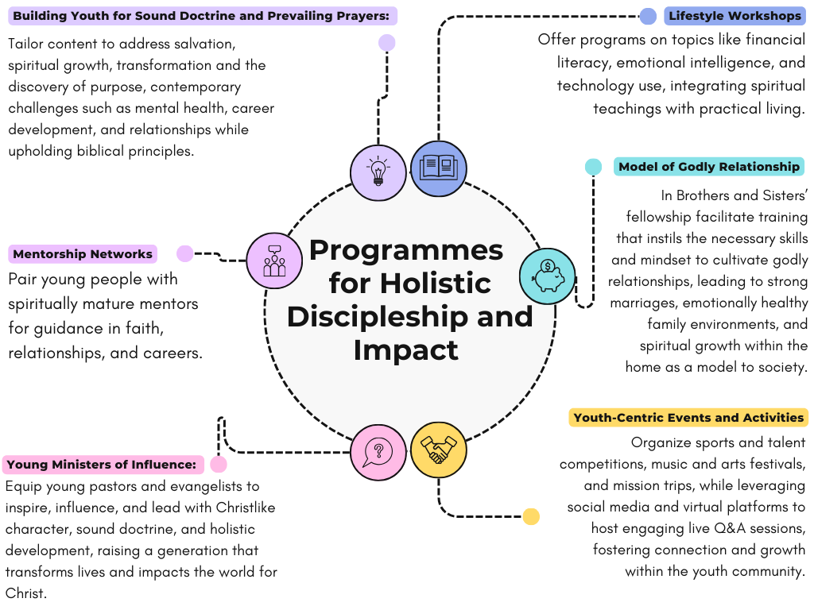

Slide 11
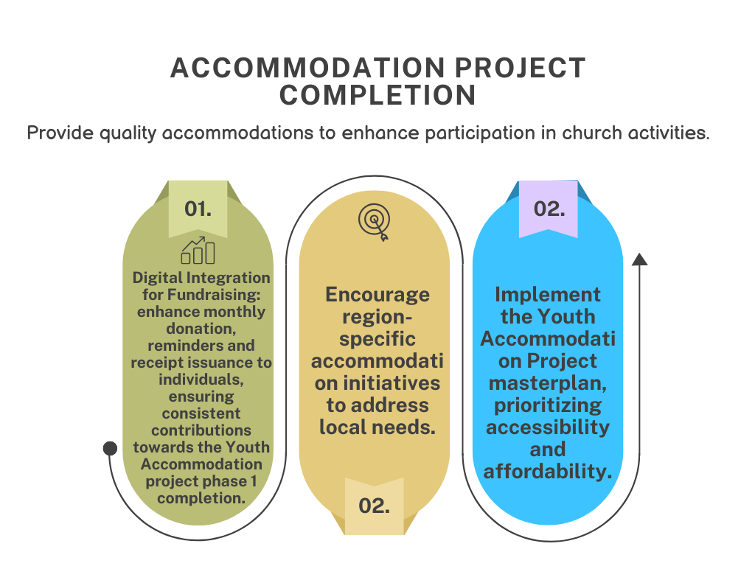

Slide 12
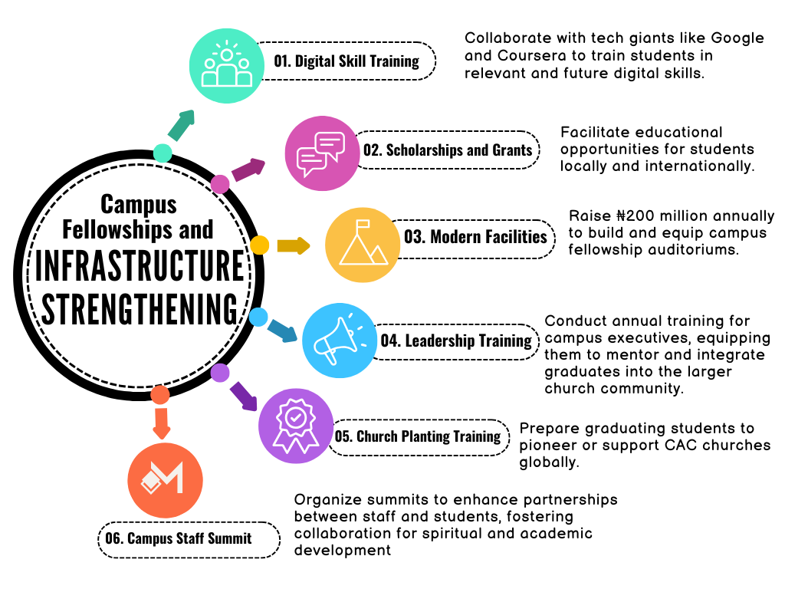

Slide 13
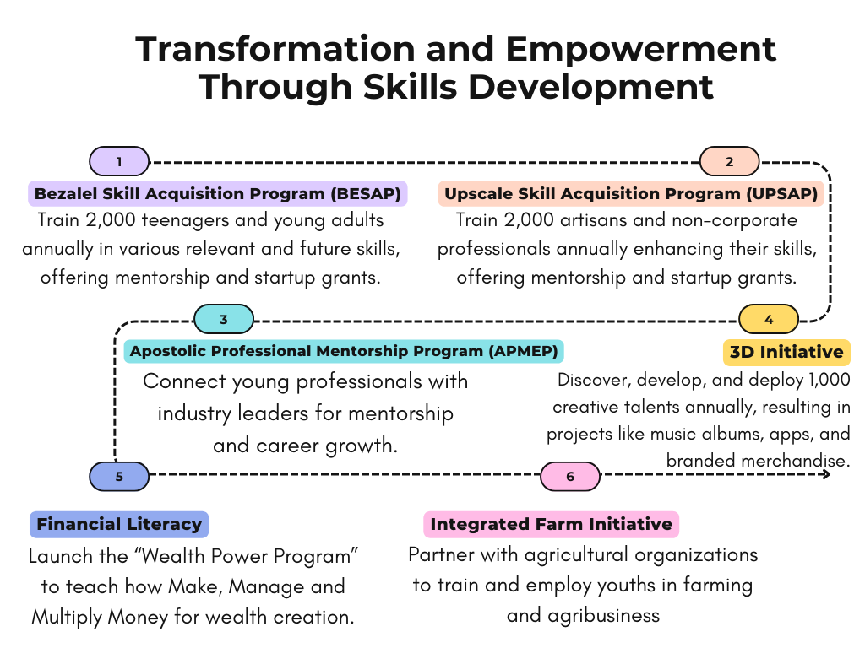

Slide 14
Conclusion
This roadmap is crafted as a vision of growth, empowerment, and transformation—an invitation to embrace the potential within the youth of our church. It captures a journey where each young member is encouraged to rise, equipped with spiritual, personal, and professional tools to make a meaningful impact for Christ.
We see a future where the youth are not just participants but pivotal agents of change, embodying values that reflect our faith and societal transformation. This roadmap is a blueprint for a dynamic, thriving youth fellowship that stands as a beacon of hope, resilience, and divine purpose. With a foundation rooted in discipleship, skills development, strategic evangelism, and sustainable growth, every aspect of this plan is designed to inspire, uplift, and guide our youth into lives of influence and service.
Dear leaders, we have come to the season where God will perform His promises to our Fathers and remember His covenant with them (Luke 1:72). As partners with God, we will raise a generation of Kings and Priests who will transform society for Christ and are ready to play the strategic roles of CAC in the end-time revival. With the guidance of the Holy Spirit and the collective efforts of all of us, this vision will become a reality—a movement of empowered young leaders, prepared to light up every corner of society with Christ’s love and wisdom. Let us rise to this call and embrace the journey of faith, excellence, revival and impact. Thank you.
Pastor Peter Olanrewaju
Director of Youth Affairs, CAC Nig & Overseas

